Slide 1
Chapter 3
Transmission media
Presented by Anil thakur
Rajendra tharu

Slide 2
Guided media
Guided media, which are those that provide a conduit from one device to another, include Twisted-Pair Cable, Coaxial Cable, and Fibre-Optic Cable. A signal travelling along any of these media is directed and contained by the physical limits of the medium.

Slide 3
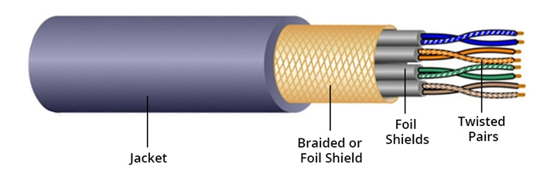
1. Twisted Pair Cable
Twisted pair cable is often used for telephone communications and most modern Ethernet networks. It is a kind of wiring in which two conductors of a single circuit are twisted together. A pair of wires forms a circuit that can transmit data. And the pairs are twisted together to provide protection against crosstalk, the noise generated by adjacent pairs.

Slide 4
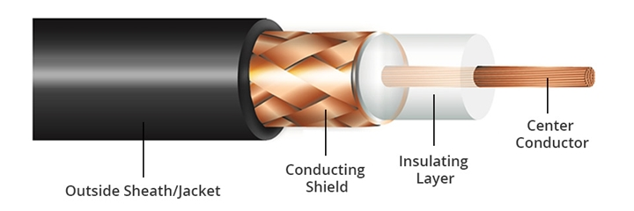
2. Coaxial Cable
Coaxial cable, or coax cable, is designed to transmit high-frequency signals. It’s comprised of a round copper conductor and three layers of insulation and shielding which prevents crosstalk from motors, lighting and other sources of EMI. With the shield construction, the coaxial cable can support longer cable lengths between two devices.

Slide 5
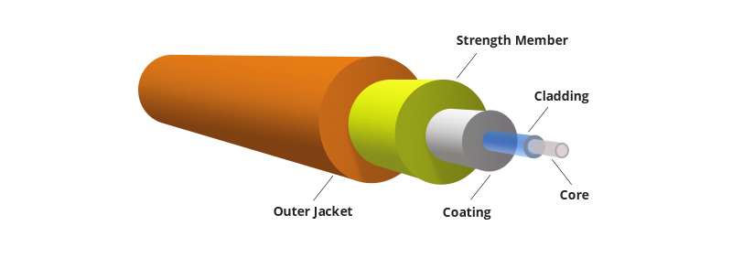
3. Fiber Optic Cable
Fiber optic cable, also called as optical fiber cable, is a type of Ethernet cable which consists of one or more optic fibers that are used to transmit data. Fiber optic cable transmits data as pulses of light go through tiny tubes of glass. The transmission capacity of optical fiber cable is 26,000 times higher than that of twisted pair cable.

Slide 6
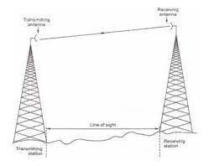
Unguided media
An unguided media type transmission is used to transmit electromagnetic waves without using any of the physical transmission media.

Slide 7
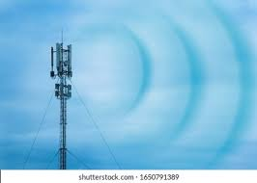
1. Radio transmission
In radio transmission a radiating antenna is used to convert a time-varying electric current into an electromagnetic wave or field, which freely propagates through a nonconducting medium such as air or space.

Slide 8
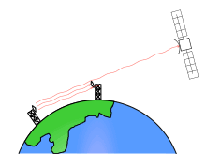
2. Microwave transmission
Microwave transmission is the transmission of information by electromagnetic waves with wavelengths in the microwave range of the electromagnetic spectrum

Slide 9

3. Satellite transmission
Satellite transmission consists of a line-of-sight propagation path from a ground station to a communications satellite (up link) and back to an earth station (down link). ... The ground station includes the antennas, buildings, and electronics necessary to transmit, receive, multiplex, and demultiplex signals.

Slide 10
Comparison Of Guided And Unguided Media
Ans
Guided Media
Unguided Media
1. The signal energy propagates through wires in guided media.
2. It is called wired communication or bounded transmission media.
3. It provides direction to signal for travelling.
4. Twisted pair cable, coaxial cable and fibre optic cable.
1. The signal energy propagates through air in unguided media.
2. It is called wireless communication or unbounded transmission media.
3. It does not provide any direction.
4. Radio wave, microwave and infrared.

Slide 11
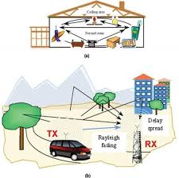
Wireless propagation
Wireless signal propagation is the movement of these radio waves (which move at the speed of light) to and from these sites and devices.

